Slide 1
Convolutional Neural Network
1.Height
2.Facial features
3. Body textures
4. Voice
5. Color
6. Shaps
7. Behaviors
8. Edges
Yann LeCun in 1988

Slide 2
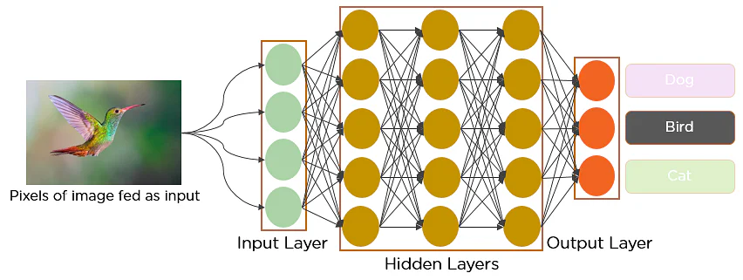
Introduction to CNN

Slide 3
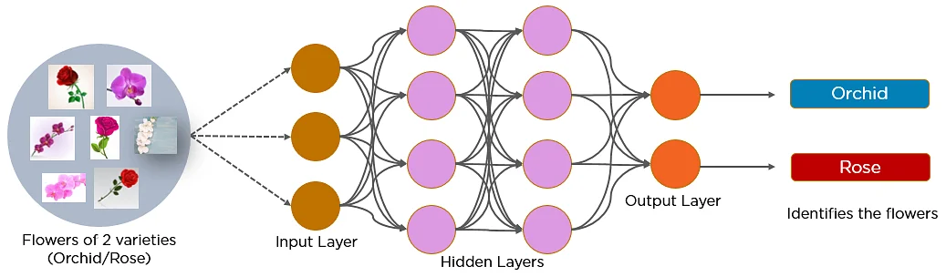
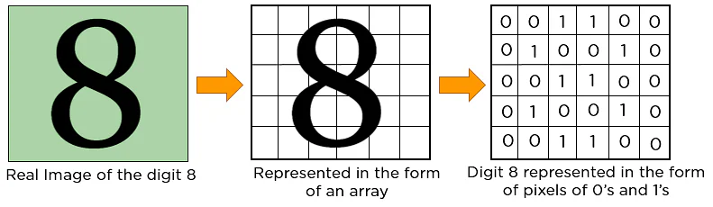
What is Convolutional Neural Network?
A convolutional neural network is a feed-forward neural network that is generally used to analyze visual images by processing data with grid-like topology. It’s also known as a ConvNet. A convolutional neural network is used to detect and classify objects in an image.
Below is a neural network that identifies two types of flowers: Orchid and Rose
In CNN, every image is represented in the form of an array of pixel values.

Slide 4
Layers in a Convolutional Neural Network
A convolution neural network has multiple hidden layers that help in extracting information from an image. The four important layers in CNN are:
Convolution layer
ReLU layer
Pooling layer
Fully connected layer
224*224*3 = 150528 input
1 1 1 0 0
0 1 1 1 0
0 0 1 1 1
1 0 0 1 0
1 1 0 0 1
1 0 1
0 1 0
1 0 1
Problems in ANN
Overfitting
Slow traning
Accuracy
Weight sharing
Features extracting

Slide 5
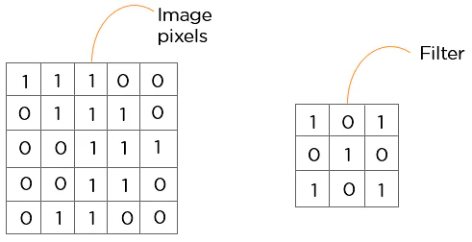
Convolution Layer
This is the first step in the process of extracting valuable features from an image. A convolution layer has several filters that perform the convolution operation. Every image is considered as a matrix of pixel values.
Consider the following 5x5 image whose pixel values are either 0 or 1. There’s also a filter matrix with a dimension of 3x3. Slide the filter matrix over the image and compute the dot product to get the convolved feature matrix.

Slide 6
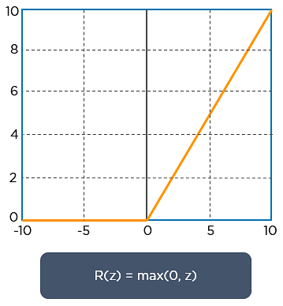
ReLU layer
ReLU stands for the rectified linear unit. Once the feature maps are extracted, the next step is to move them to a ReLU layer.
ReLU performs an element-wise operation and sets all the negative pixels to 0. It introduces non-linearity to the network, and the generated output is a rectified feature map. Below is the graph of a ReLU function:

Slide 7
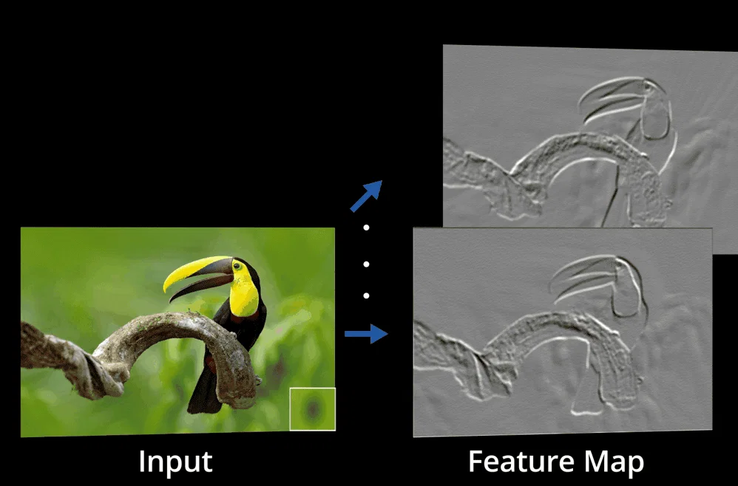
ReLU layer
The original image is scanned with multiple convolutions and ReLU layers for locating the features.

Slide 8
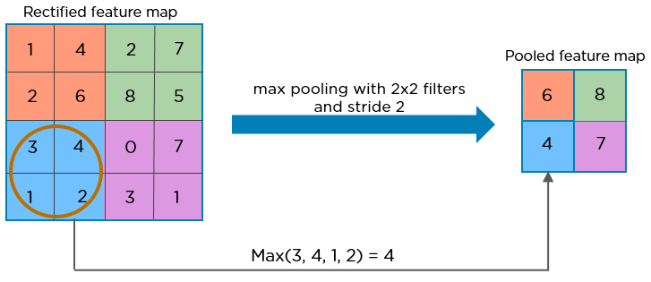
Pooling layer
Pooling is a down-sampling operation that reduces the dimensionality of the feature map. The rectified feature map now goes through a pooling layer to generate a pooled feature map.
The pooling layer uses various filters to identify different parts of the image like edges, corners, body, feathers, eyes, and beak.

Slide 9
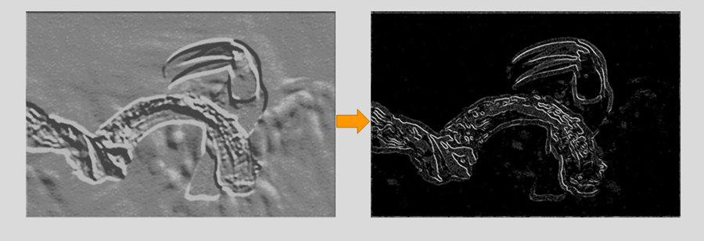
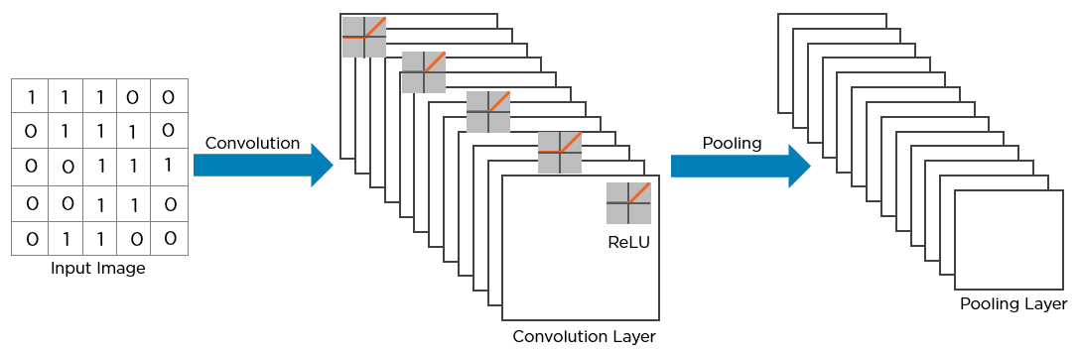
Pooling layer
Here’s how the structure of the convolution neural network looks so far:

Slide 10
Flattening layer : -
7 * 7 *64 = 3136
3136 *1

Slide 11
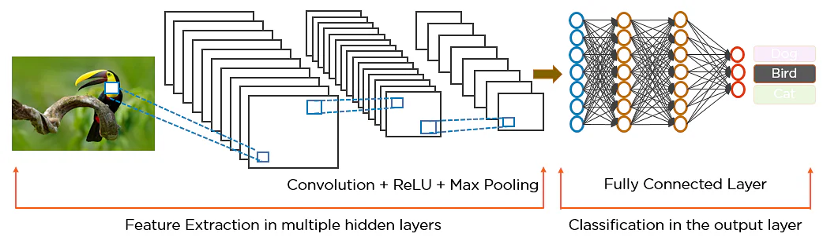
Here’s how exactly CNN recognizes a bird:
The pixels from the image are fed to the convolutional layer that performs the convolution operation
It results in a convolved map
The convolved map is applied to a ReLU function to generate a rectified feature map
The image is processed with multiple convolutions and ReLU layers for locating the features
Different pooling layers with various filters are used to identify specific parts of the image
The pooled feature map is flattened and fed to a fully connected layer to get the final output

Slide 12
Pipeline of CNN
Image
Convolutional
ReLu Layer
Polling Layer
Flattening layer
Fully connected layers
Final predictions

